Slide 1
Ray Tracing Using Map Reduce
Group 8
Bhavika Kalani
Raghav Bhandari
Yuan-Lin Hsu

Slide 2
Motivation
Rasterizing methods (open GL) render 3D images quickly, however quality suffers.
Incorporating additional effects limits performance like shadows, reflection, refraction etc.
Limitation exists on the type of object that can be used.

Slide 3
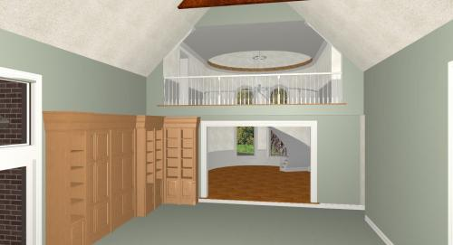
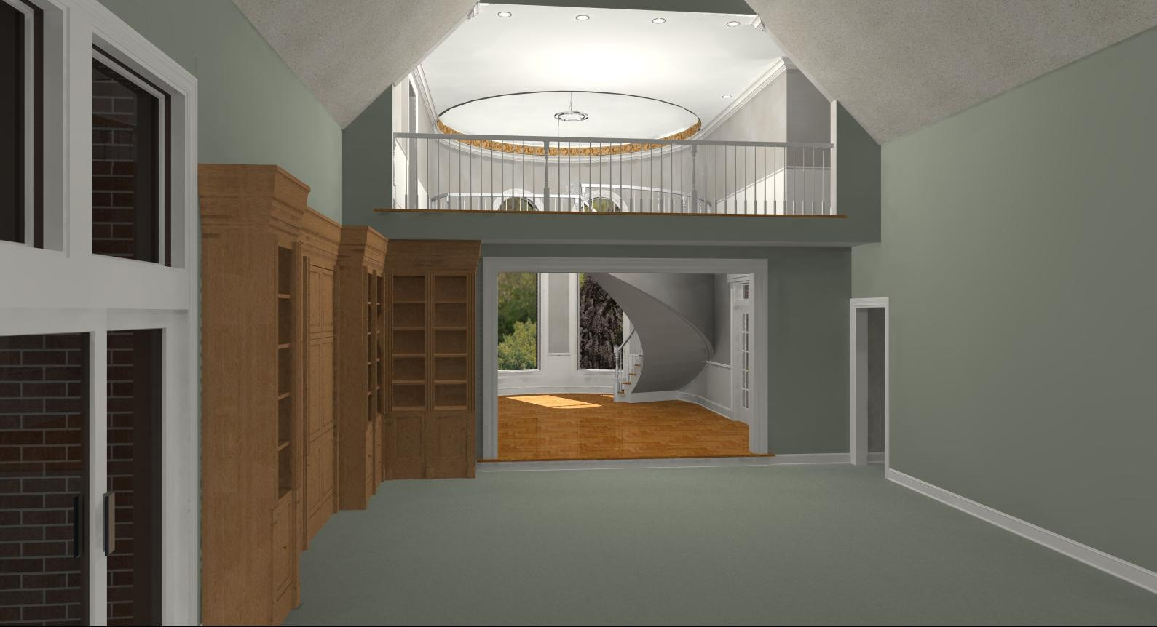

Slide 4
Benefits of Ray tracing
As the path of the ray is traced through the scene
Effects such as shadowing , reflection and refraction are easy to incorporate
Can also work with richer class of geometric objects than polygon meshes
Solid (vector) objects, spheres, cones, cylinder
Each shape is represented exactly through a mathematical expression
Not necessary to approximate like a mesh

Slide 5
How can we do better
Lights, camera and surface
Common denominator – Photons
Photons
“Particles of light”- quanta of electromagnetic energy
Appear to be particles and waves simultaneously (ignore wave i.e diffraction and simulate particle)
Model photons as “Rays” (location and magnitude)

Slide 6
Forward Ray Tracing

Slide 7
Solution- Backward Ray Tracing

Slide 8
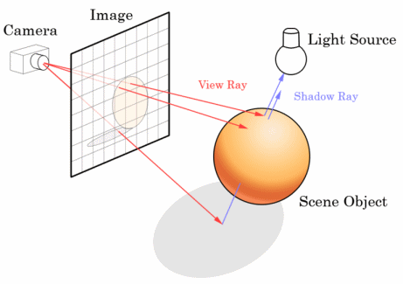
Ray Tracing
Ray tracing models the frame buffers an array of pixels positioned in space with the eye looking through the buffer into the object
For each pixel we ask what do we see?

Slide 9
In practice ray tracing follows a ray
From the eye, through the pixel center, out into the scene
Its path is tested against each object in the scene
To see which object it hits first and at what point
A parameter t is used to associate the ray’s position with an abstract notion of time
Parametric equations – the ray is here now , the ray reaches this point first

Slide 10
Pseudocode
<define objects, light source and cameras in the scene>
For (int r=0; r<nRows; r++)
For (int c=0; c<nCols; c++)
<1.Build the rc-th ray>
<2.Find all intersections of the rc-th ray with objects>
<3.Find intersection which lie closest to the eye>
<4.compute the hit point where the ray hits this object, and the normal vector at that point >
<5.Find the color of the light returning to the eye along the ray from point of intersection>
<6.Place the color in the rc-th pixel>

Slide 11
Apache Ambari Installation
Steps to install:
Download the ambari.repo file from the public repository
where OS can be CentOS, SLES, Ubuntu, or Debian (Linux).
2. Setup the Fully Qualified Domain Name(FQDN) for the cluster, setup the SSH passwordless login.
3. Install the ambari-server package.
4. Setup and start running ambari-server.

Slide 12
Ambari System requirements:
Operating System | Browser
Linux | Chrome 56.0.2924.87, 57.0.2987
 | Firefox 51, 52
Mac OS X | Chrome 56.0.2924.87, 57.0.2987
 | Firefox 51, 52
 | Safari 10.0.1, 10.0.3
Windows* | Chrome 56.0.2924.87, 57.0.2987
 | Edge 38
 | Firefox 51.0.1, 52.0
 | Internet Explorer 10, 11
JDK Requirement : JDK 8+
Database Requirement: MySQL 5.6++, Oracle 11, Oracle 12
For Ubuntu 14, Ubuntu 16: Python 2.7.x
Ambari host should have at least 1 GB RAM, with 500 MB free.

Slide 13
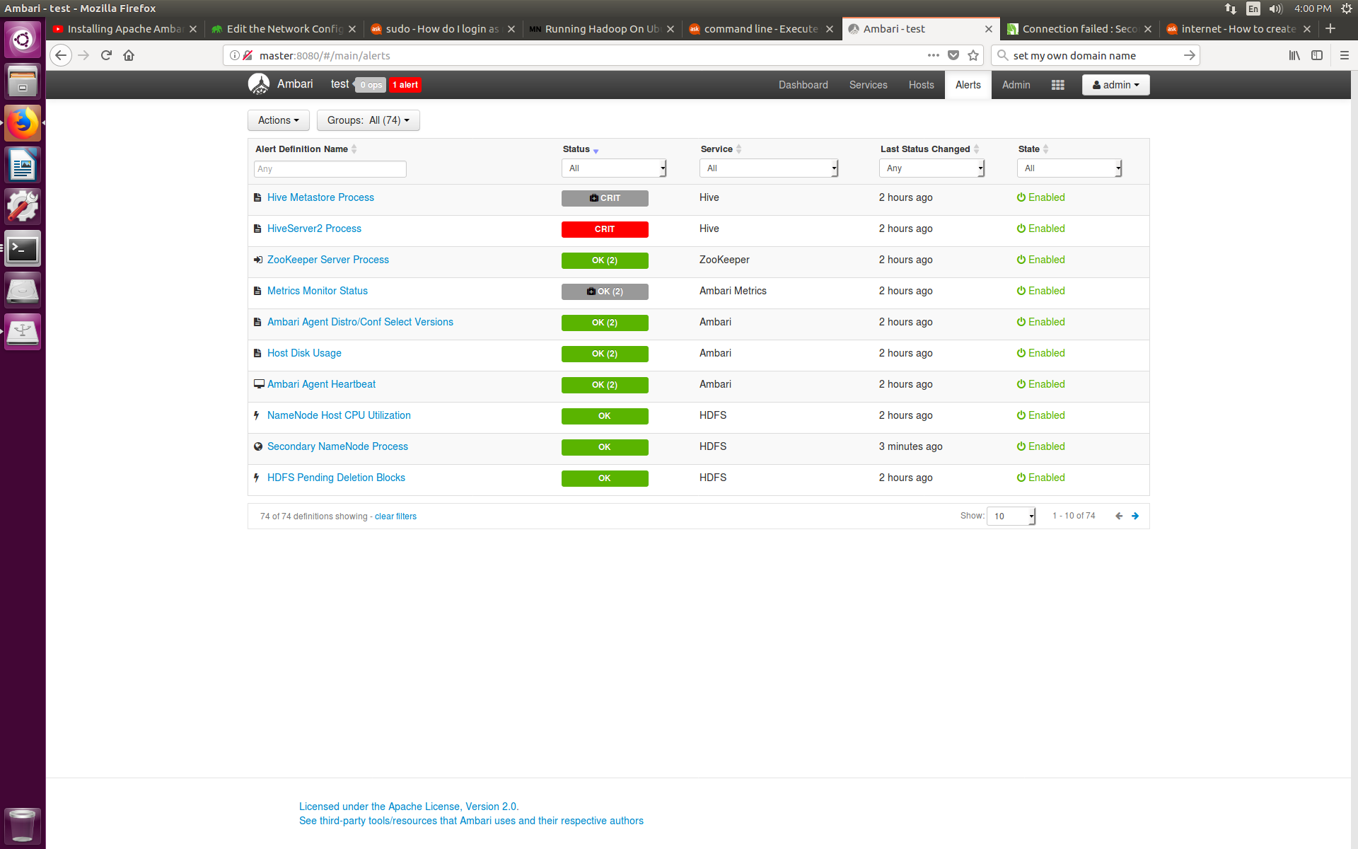
Ambari Alerts:

Slide 14
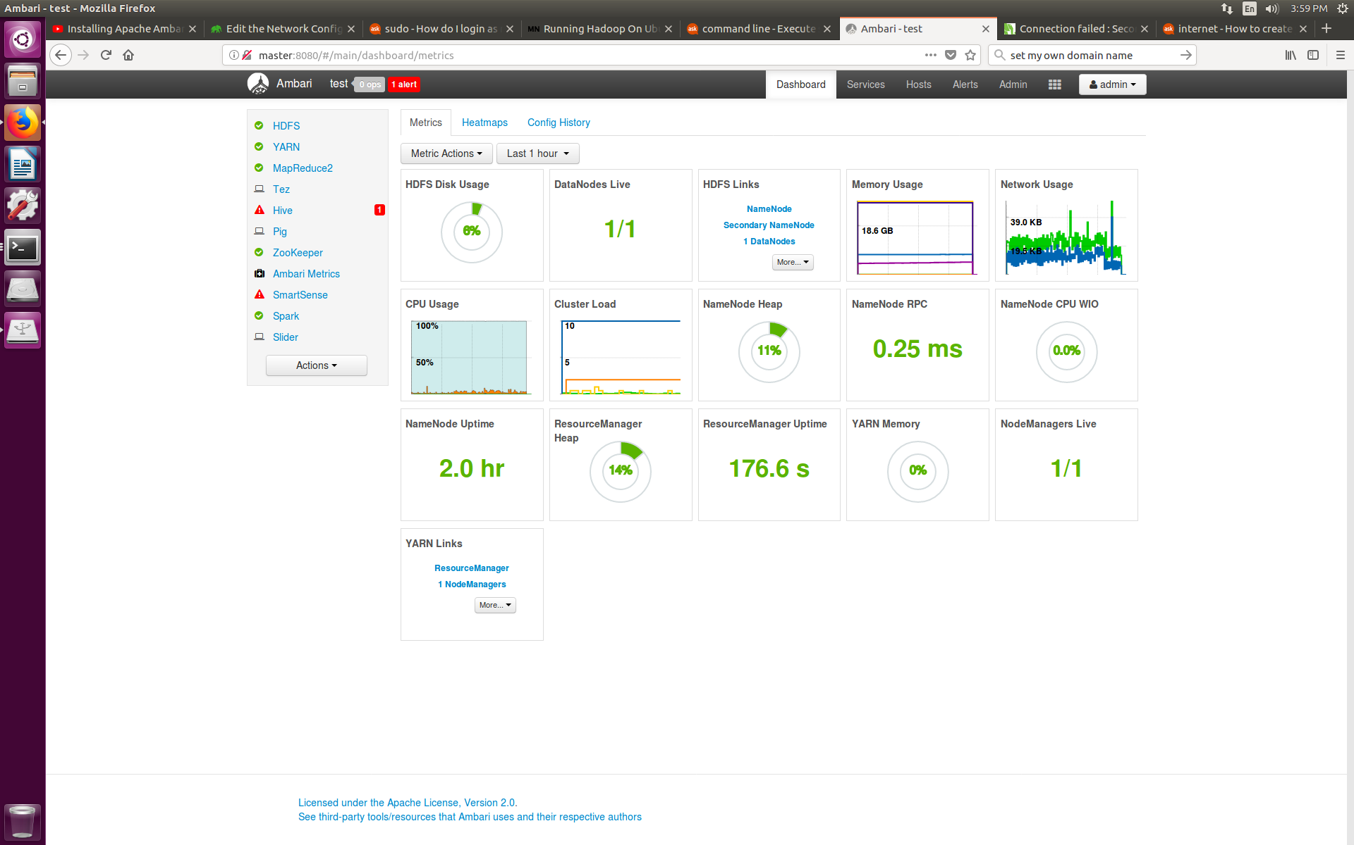
Ambari Dashboards:

Slide 15
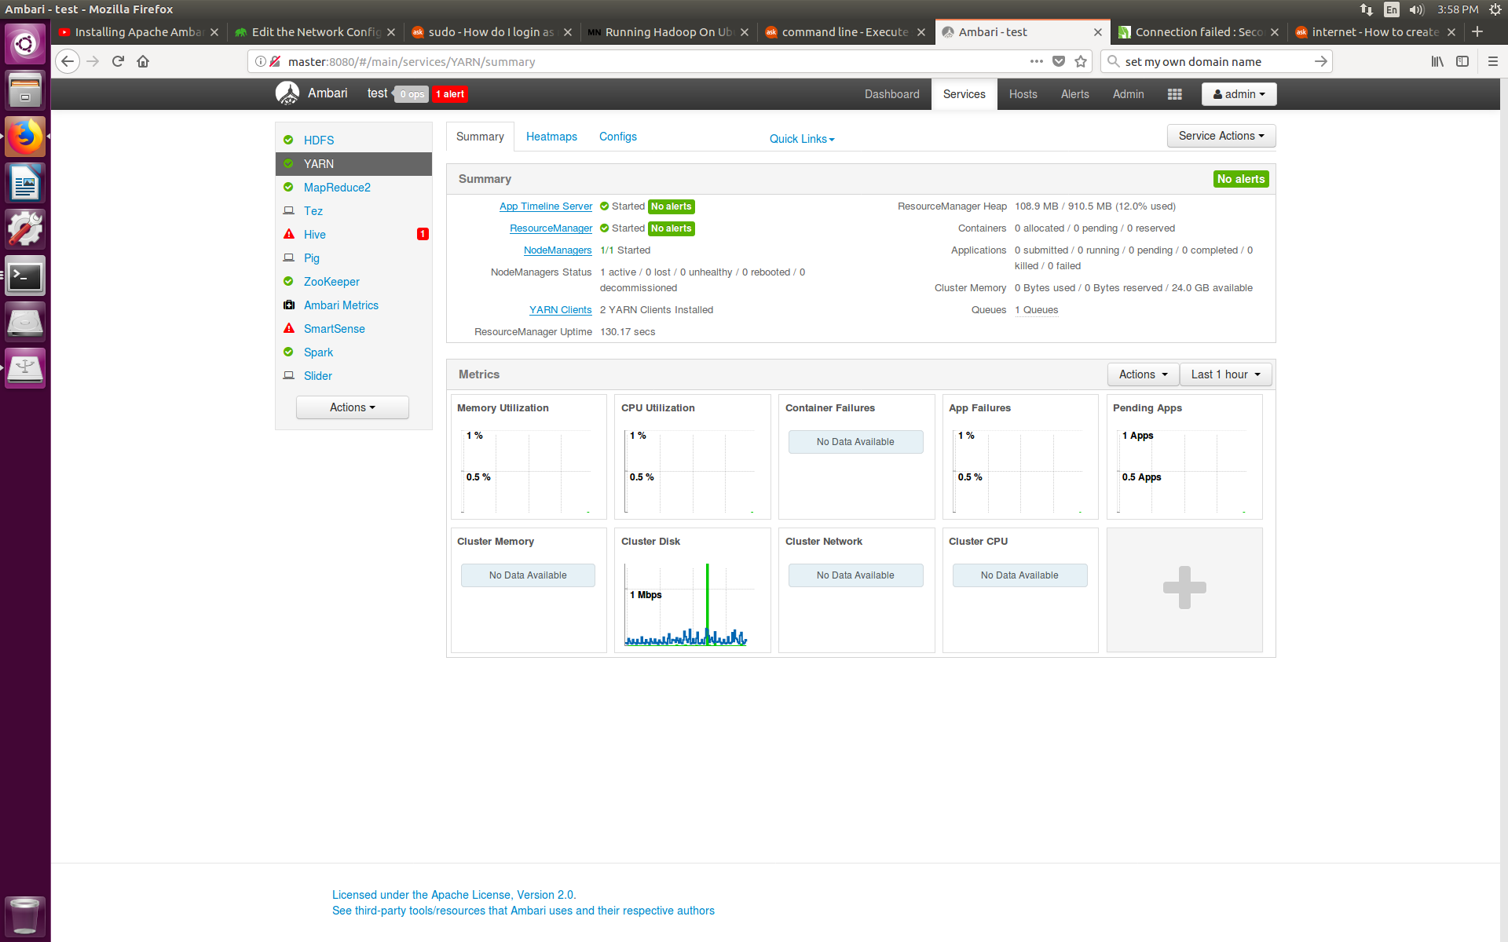
Ambari Services:

Slide 16
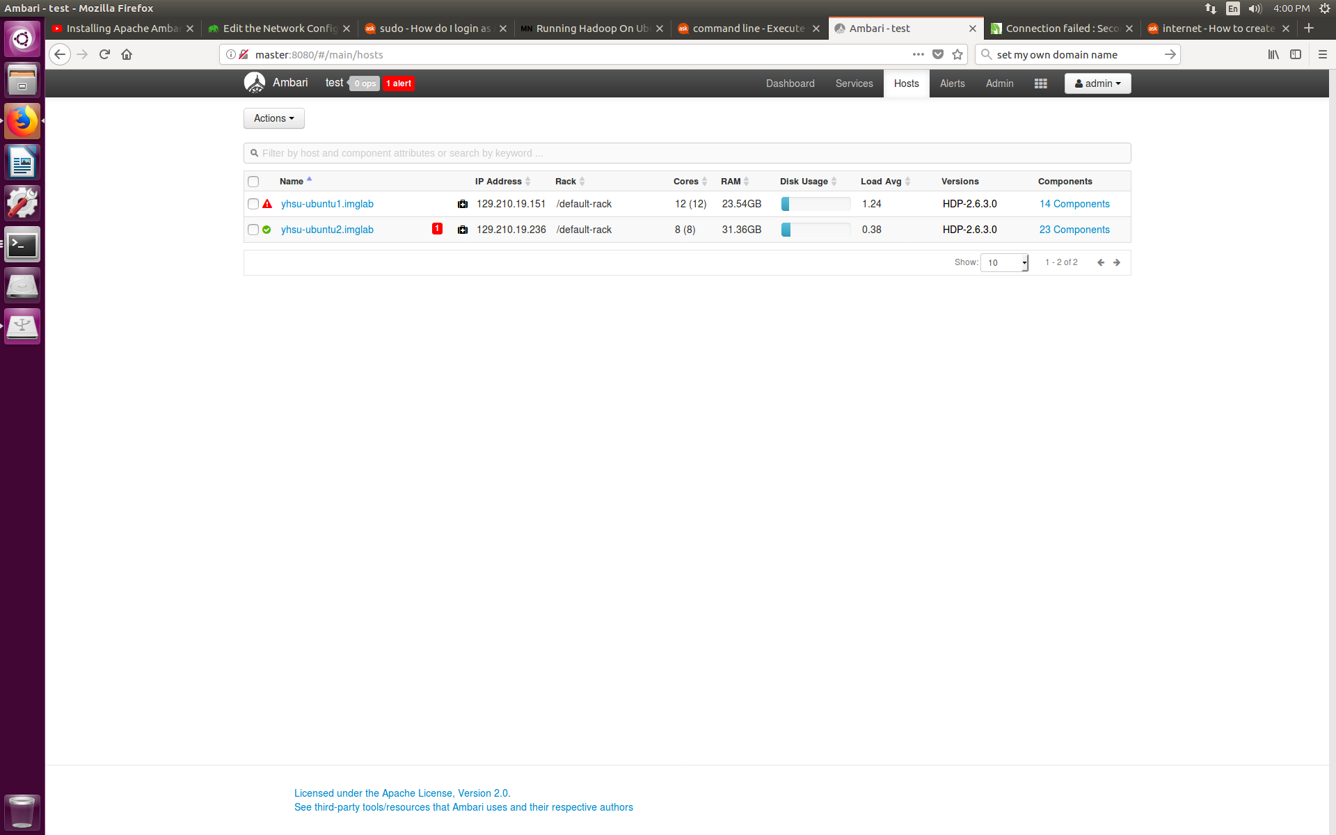
Ambari Hosts:

Slide 17
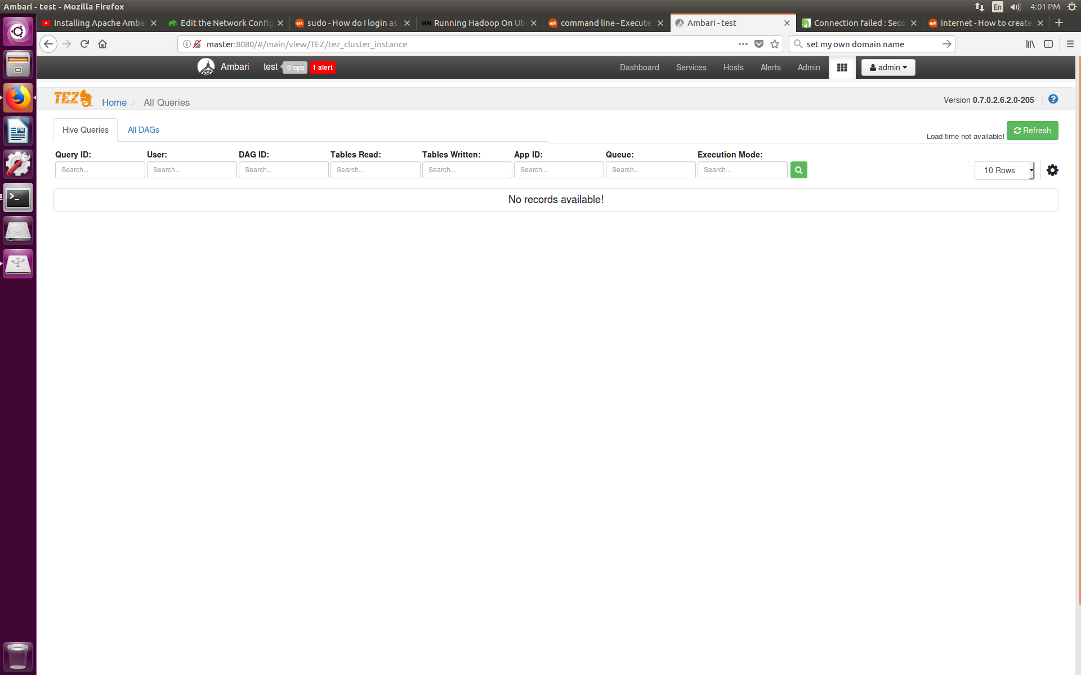
Ambari Tez-view:

Slide 18
Advantages of Ambari
Graphical user interface makes it user friendly, as compared to cmd line arguments.
Everything is in a cohesive unit, so we do not have manually install other software and worry about compatibility issue.
Scaling up is easier, when adding new nodes, Ambari will automatically do the setup.

Slide 19
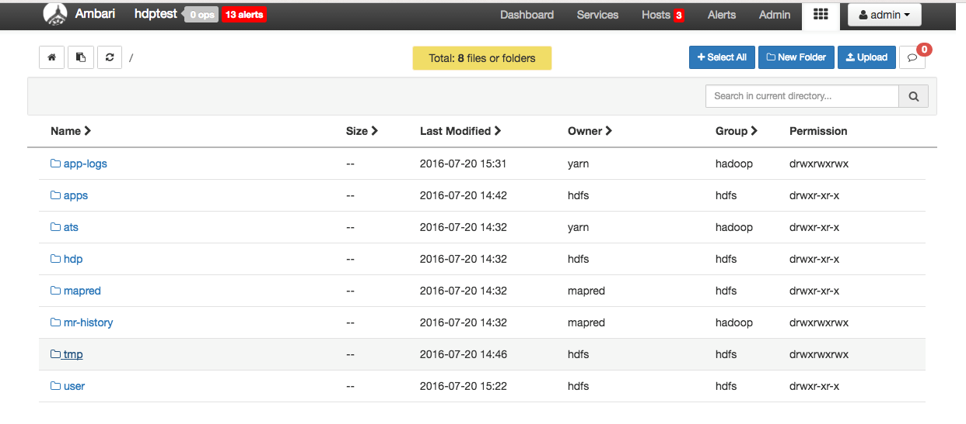
Ambari File view:
Navigation for HDFS
Transmission between Linux/HDFS files systems

Slide 20
Raytracing with CPU cluster
Raytracing is state of the art CG rendering technique, but requires lots of computational power.
By using cluster, we can distribute tasks with divide and conquer paradigm and gain speed advantage.
Therefore how to divide and distribute the task is crucial for optimization.
We focus on optimizing the computing time of a single frame rendering.

Slide 21

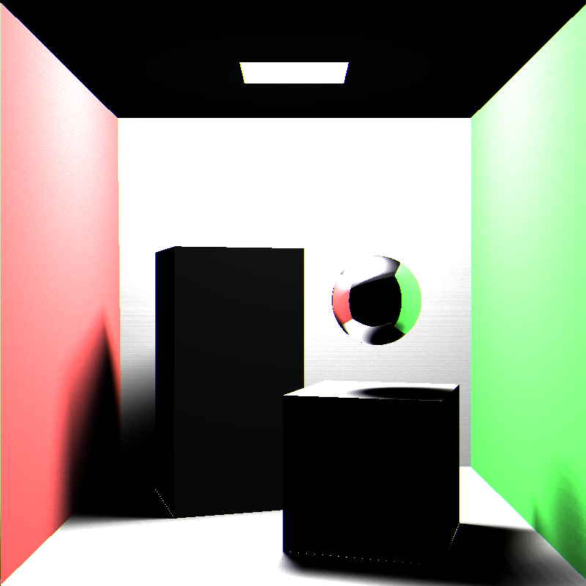
Original method: Horizontal Split
Split Input into horizontal regions.
Map: Do the raytracing work.
Reduce: Put back result together.

Slide 22
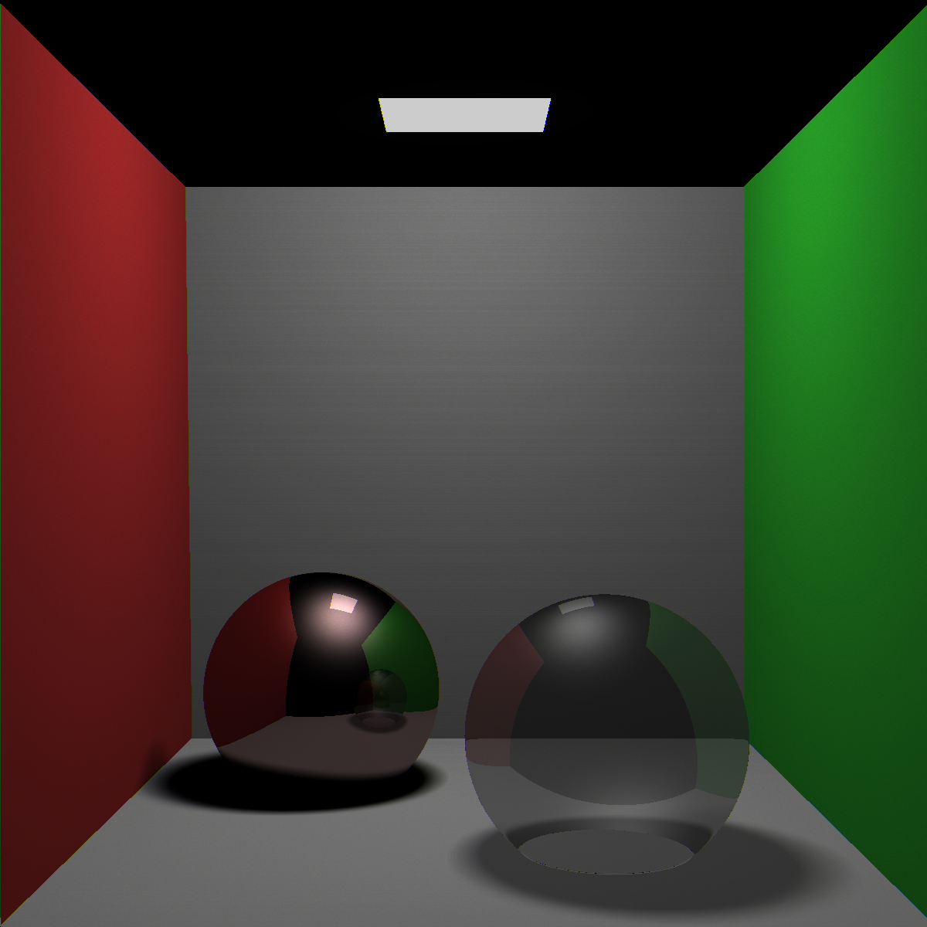
Problem with this approach
Workload imbalance:
Because the split region is continuous, if the computing heavy (e.g. transparent/reflective) objects are distributed in one region, that region would need a lot of time to render.

Slide 23
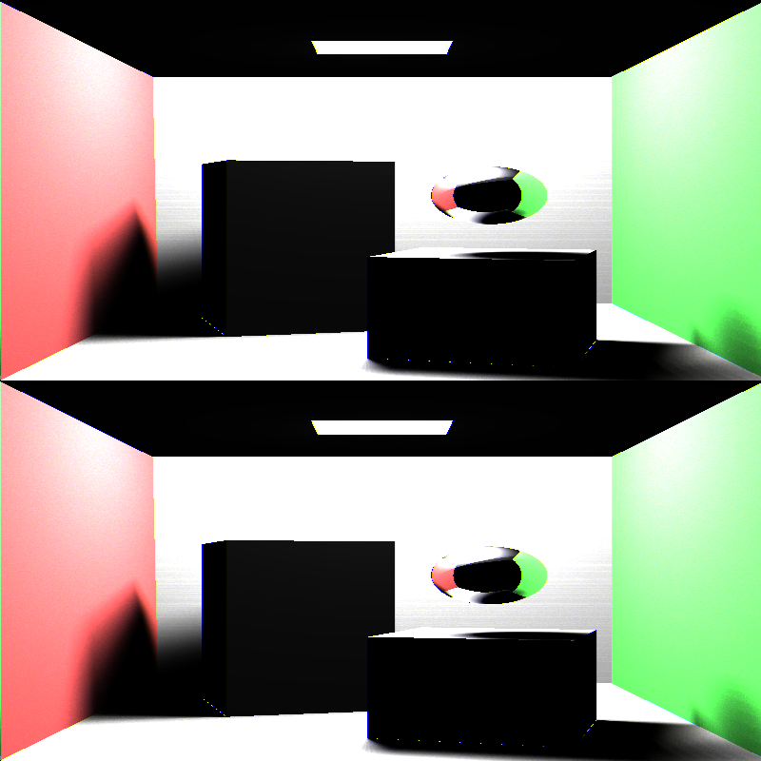
Our approach : Alternate Split
1. Split input by alternate horizontal rows (Odd/Even).
2. Map.
3. Reduce.
4. Postprocessing rearrange.

Slide 24
Experiment: Environment
HW
2 machine
Node 1: Xeon W3690 (6 core/12 virtual core)3.47Hz+24GB memory
Node 2: XeonE5-1620 3.7GHz *8+31.4GB memory
SW:
Ambari deployed on the cluster, with HDFS, YARN and MapReduce2.

Slide 25
Experiment: render target
Scene | Resolution | Content
basiccornellbox | 800/800
cornellbox | 1200/1200

Slide 26
Experiment Result: Running time
Rendering Target | Single Node | 2 node horizontal split (original) | 2 node alternate split (our method)
 | 62870 ms | 41759 ms | 41724 ms
 | 121448 ms | 94944 ms | 72887 ms+

Slide 27
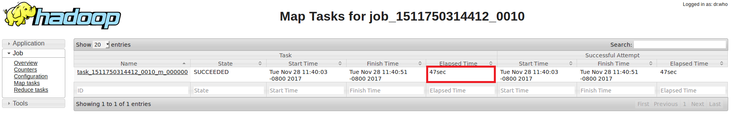
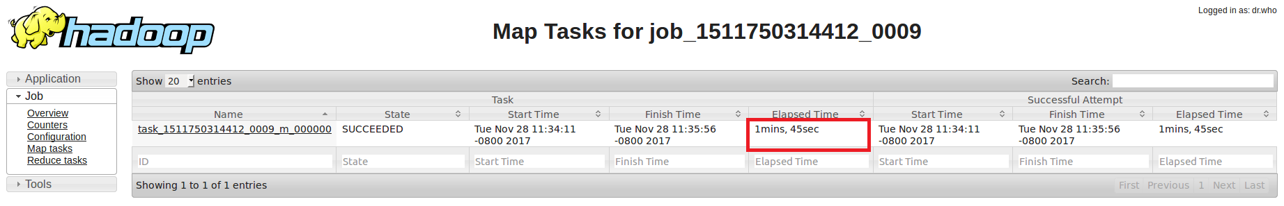
Map task elapse time: Single Node
Overhead time = 16 sec

Slide 28
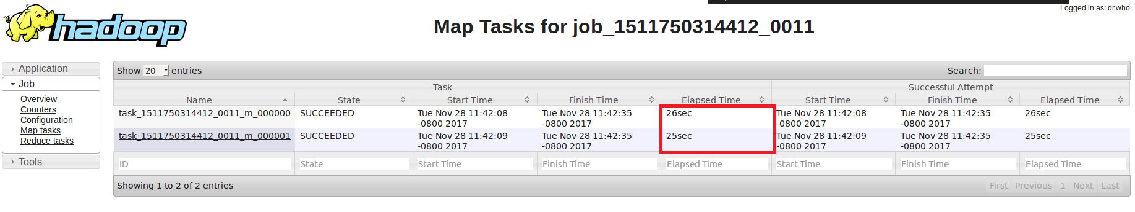
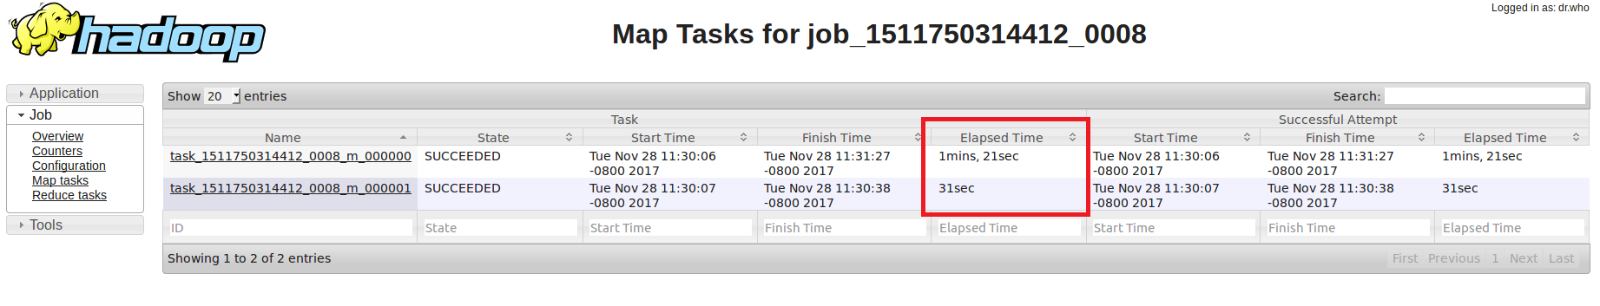
Map task elapse time: Horizontal
Overhead time = 23 sec

Slide 29
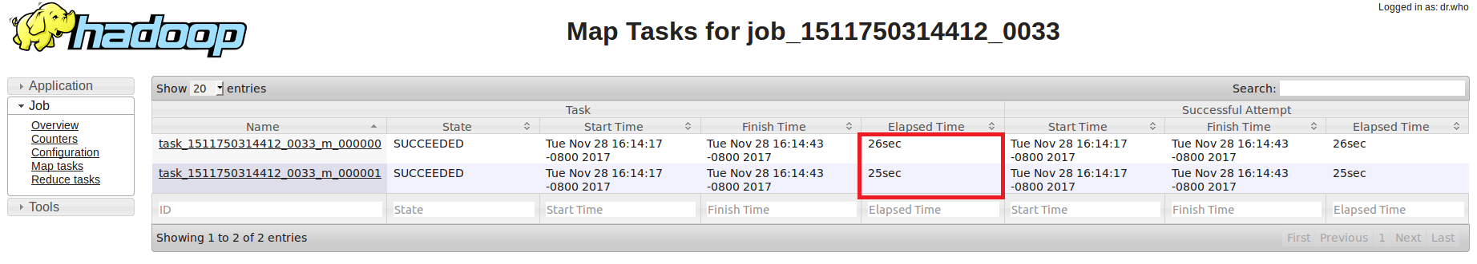
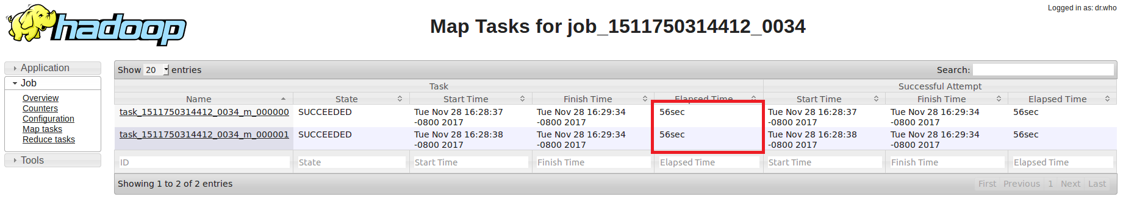
Map task elapse time: Alternate
Overhead time = 23 sec

Slide 30
Conclusion
In this project, we did the following things:
Setup a Scalable Hadoop cluster.
Research on the ray tracing algorithm.
Optimize the workload balance.
Future Scope:
Better division algorithm for the workload by sampling.
Use a mixture of GPU and CPU.

Slide 31
Thank You!!

